Slide 1
Testing
Advanced Unity

Slide 2
Content
Why we need Tests
How to do Tests in Unity
How to Start
NUnit
Real life Exercise
Play Mode Tests
Unity Test Framework Limitations

Slide 3

Why we need Tests
When building code, many things can go wrong.
Someone can type something wrong
Someone can change someone else code without being aware of it
Someone can remove someone else code without being aware of it
Someone can add code for new behaviour that collides with the old behaviours code
Someone can forget old requirements when building new ones
Someone == You

Slide 4

Imagine having a magic button that when pressed would inform you if there are bugs in your code.

Slide 5
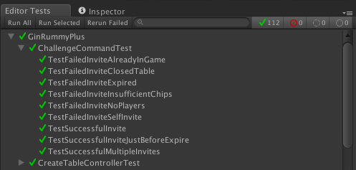
That’s exactly what Tests do:

Slide 6
How to do Tests in Unity
How to Start
Test Runner window
Assemblies for Tests
Editor vs Play Tests
NUnit
Tests Structure
Tests Attributes
AAA Pattern
Naming

Slide 7
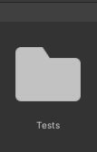
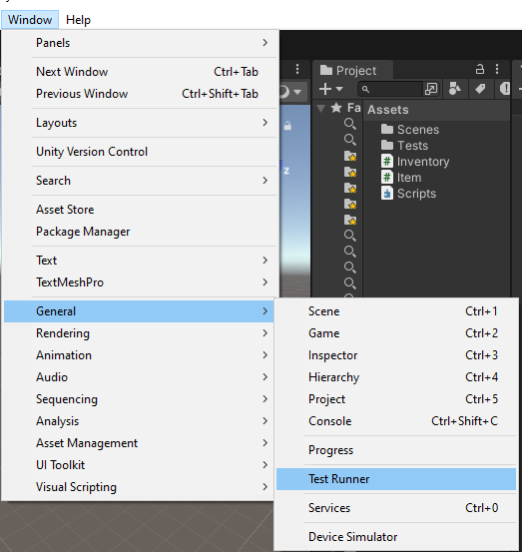
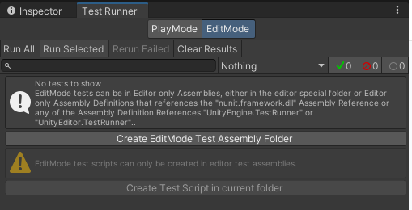
How to Start

Slide 8
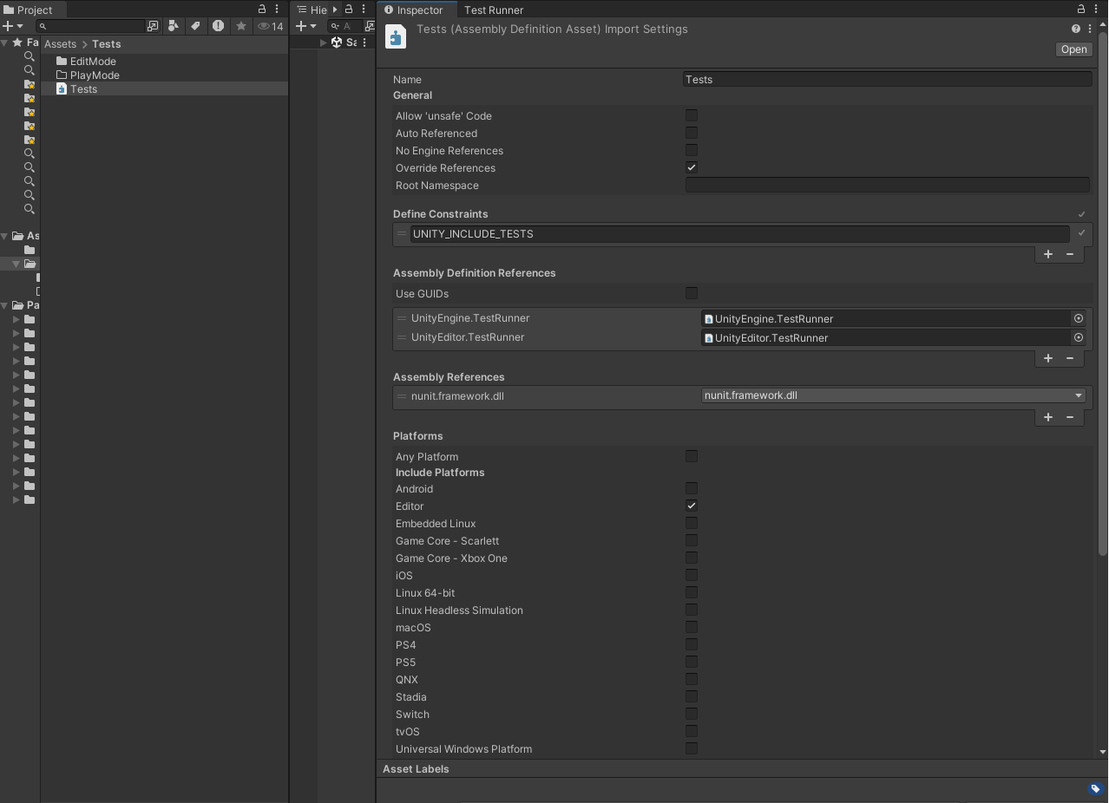
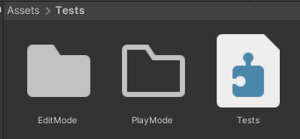
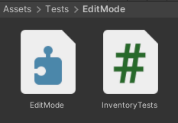

How to Start

Slide 9
NUnit
NUnit is a C# testing library used to write and run automated code tests.
It is part of a set of tools that help developers ensure that their code works correctly, especially when working on large or complex projects.
Simply put, NUnit helps you verify that your code works correctly by running automated tests, which can be run at any time to confirm that no bugs were introduced during development.

Slide 10
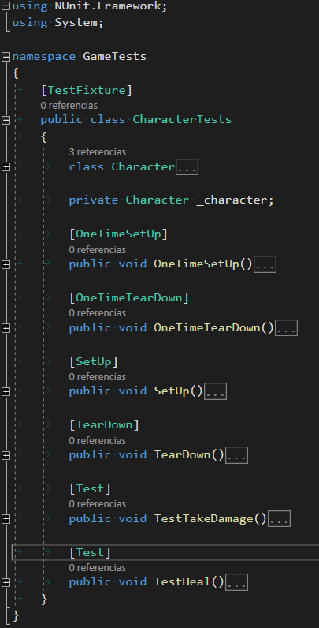
NUnit
OneTimeSetUp
SetUp
Test
TearDown
SetUp:
Test
TearDown
OneTimeTearDown

Slide 11
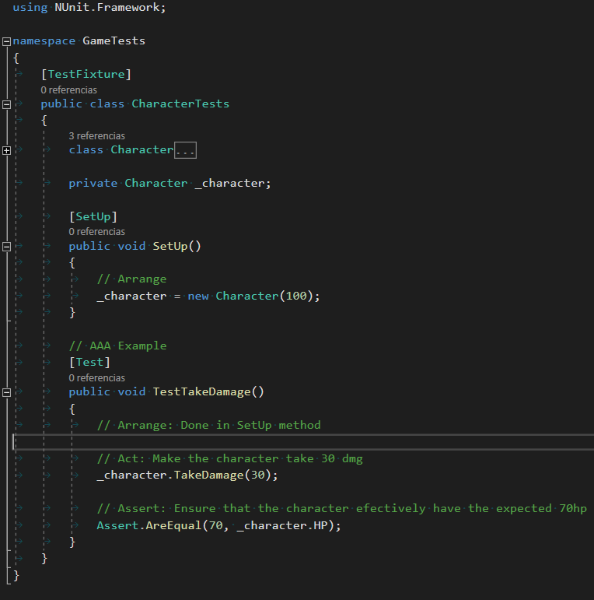

AAA Pattern
Arrange
Act
Assert

Slide 12
Naming
When_{condition}_Expect_{result}
There are many naming conventions.
Microsoft suggests the following one:
But my favorite, and the one that my company actually uses is:
{name of the method being tested}_{scenario under which it’s being tested}_{expected behaviour when scenario is invoked}

Slide 13
Tests Structure - Naming
Microsoft:
TakeDamage_WhenCharacterTakes30Damage_ExpectHPToBe70
Eric:
When_CharacterTakes30Damage_Expect_HPToBe70
What really matters is CONSISTENCY

Slide 14
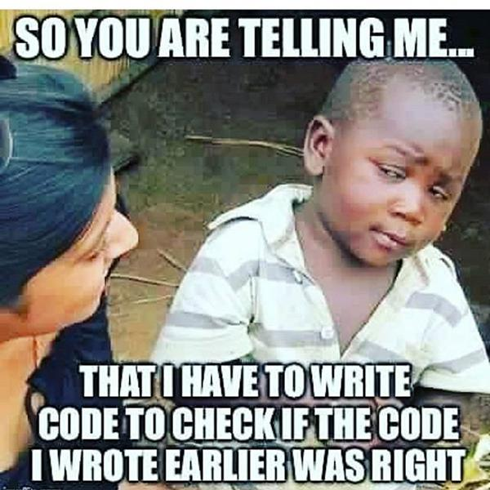

Slide 15
Is hard to understand
WHY
is helpful to learn to do
Testing
So… EXERCISE!

Slide 16

Exercise - Inventory System
Our boss wants to implement an Inventory system for our videogame.
He says that it will be VERY simple:
We only need the functionality of adding and removing items from our inventory.
This is very common in the industry, be aware of THOSE types of signals!
Bosses usually don’t know anything about programming, so they don’t KNOW if it’s SIMPLE or not.

Slide 17
Exercise - Inventory System
You already mentioned that usually Inventory systems have more restrictions, and after some testing your Boss confirms what you already knew:
We need to add some restrictions to our inventory.
So he decides to implement something VERY innovative:
We literally needs to add a maximum amount of items to our inventory.
Did you learn the lesson?

Slide 18
At this point if you are smart you can realize that more changes will come regarding to the inventory.
And it’s quite time consuming testing inventories so…
let’s do some tests?

Slide 19
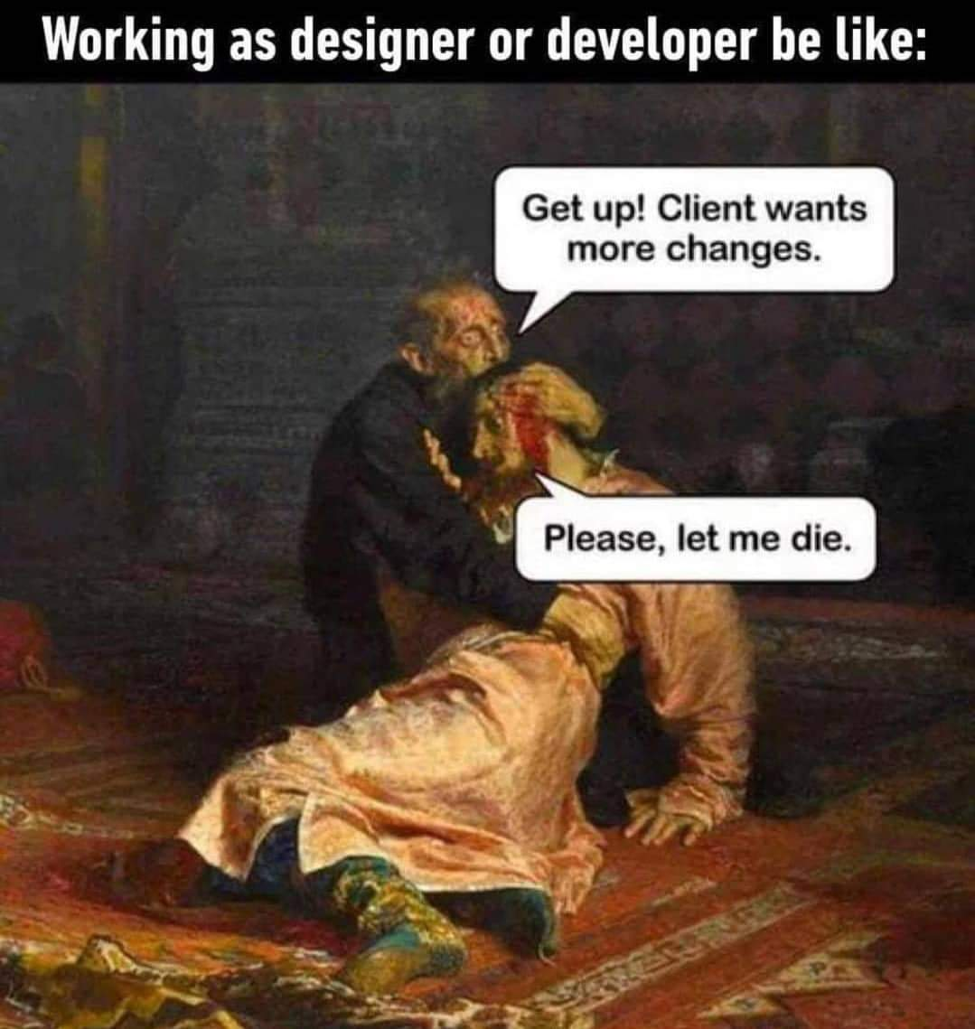
Exercise - Inventory System
After some iterations with QA and Beta Testers, we found that having 29489 individual items of the same thing in the bag, it’s pretty inconvenient.
So our boss comes to the rescue and says that know we are going to add another feature to the inventory system.
We want to stack our items, but we are going to have different stack limits for each item

Slide 20
Exercise - Inventory System
Our inventory system works like a charm for some weeks, when suddenly your boss, very angry, tolds you that the inventory system is broken, and it’s your fault.
You know it’s not, your system was working previously, right?
So you open the project and run the tests when suddenly….wait, what?!

Slide 21

That’s the reason why CI/CD exists,
but that’s a story…
for another day

Slide 22
Okey, I see the value in that now…
Btw, You also mentioned something about
Play Mode Tests?

Slide 23
Unity Test Framework limitations
Unity Test Framework version 2.0.1 includes the following known limitations:
The UnityTest attribute does not support WSA platform.
The UnityTest attribute does not support Parameterized tests (except for ValueSource).
The UnityTest attribute does not support the NUnit Repeat attribute.
Nested test fixture cannot run from the Editor UI.
When using the NUnit Retry attribute in PlayMode tests, it throws InvalidCastException.
Parameterized tests do not work when tests are generated at runtime.
The test tree in the UI is built before the run and only displays tests matching the tree at that time. Any test completely behind a define (e.g. if #UNITY_ANDROID) will still run, but the result will not show up in the Editor. The workaround for this is to have only the body of the test method behind the define.
https://docs.unity3d.com/Packages/com.unity.test-framework@2.0/manual/index.html

